Slide 1
CAR RENTAL MANAGEMENT SYSTEM
Presented by: P.Pavan Viresh, V.Sai Bhanumathi
Roll No: 2620040035, 2620040169

Slide 2
Abstract
A console-based Java application for managing basic car rental operations.
• Add and view cars
• Rent cars and calculate charges
• Return cars and update availability
• Display car categories
Uses classes, objects, ArrayList, arrays, methods, loops, conditions and exception handling.

Slide 3
Understanding Problem Statement
Problem: Manual tracking of cars, rental status and charges can be confusing.
Objectives:
• Store car name, daily price and rental status
• Show car availability
• Prevent renting an already-rented car
• Validate rental days and car number
• Calculate rental charges
Scope: Data is stored in memory and resets when the program ends.

Slide 4
CO 1 — Problem Analysis
The project divides the problem into smaller operations:
• Add a car
• View all cars
• Rent a car
• Return a car
• View car types
The main menu lets the user select an operation. Each menu choice calls a separate method.

Slide 5
CO 2 — Classes and Objects
Car class fields:
• name — car name
• price — rental price per day
• rented — availability status
The constructor initializes name and price, and sets rented to false.
Example: new Car(name, price) creates a new car object.

Slide 6
CO 3 — Arrays and Collections
• String[] carTypes stores four fixed categories: Hatchback, Sedan, SUV and Luxury.
• ArrayList<Car> cars stores a variable number of car objects.
• add() inserts a car; get() accesses a car; size() gives the number of cars.
• for loops display car details and categories.

Slide 7
CO 4 — Methods and Control Flow
• addCar() — adds a car
• viewCars() — displays car details
• rentCar() — rents a car and calculates the charge
• returnCar() — marks a car available
• viewCarTypes() — lists categories
• main() — controls the menu
A do-while loop repeats the menu; switch selects an operation; if-else checks conditions.

Slide 8
CO 5 — Validation and Exception Handling
The program checks that:
• The car list is not empty
• The selected car is not already rented
• Rental days are greater than zero
• The car number refers to a valid list index
try-catch handles IndexOutOfBoundsException and displays “Invalid car number!”

Slide 9
CO 6 — Input, Processing and Output
Input: Scanner reads menu choices, car details, car number and rental days.
Processing:
• Store car objects
• Check availability
• Calculate charge = price per day × number of days
• Update rented status
Output: Car details, rental charges and confirmation/error messages.

Slide 10
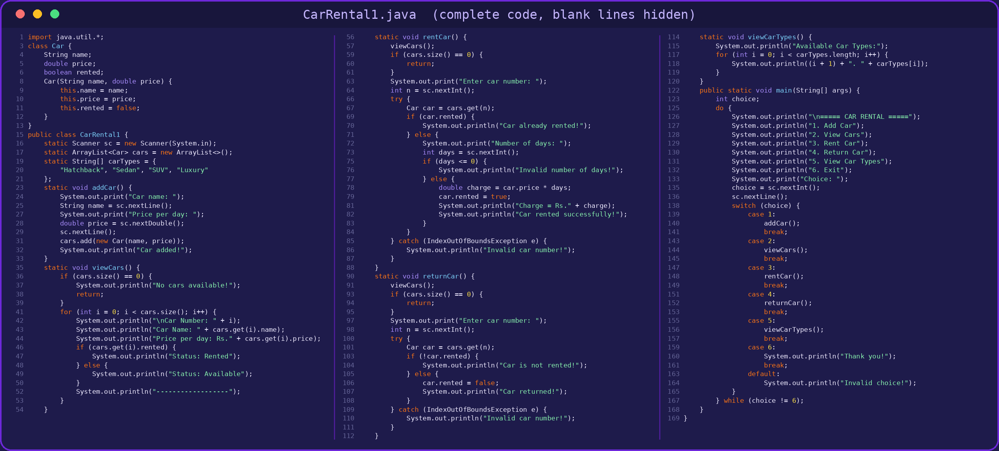
Program Code — CarRental1.java

Slide 11
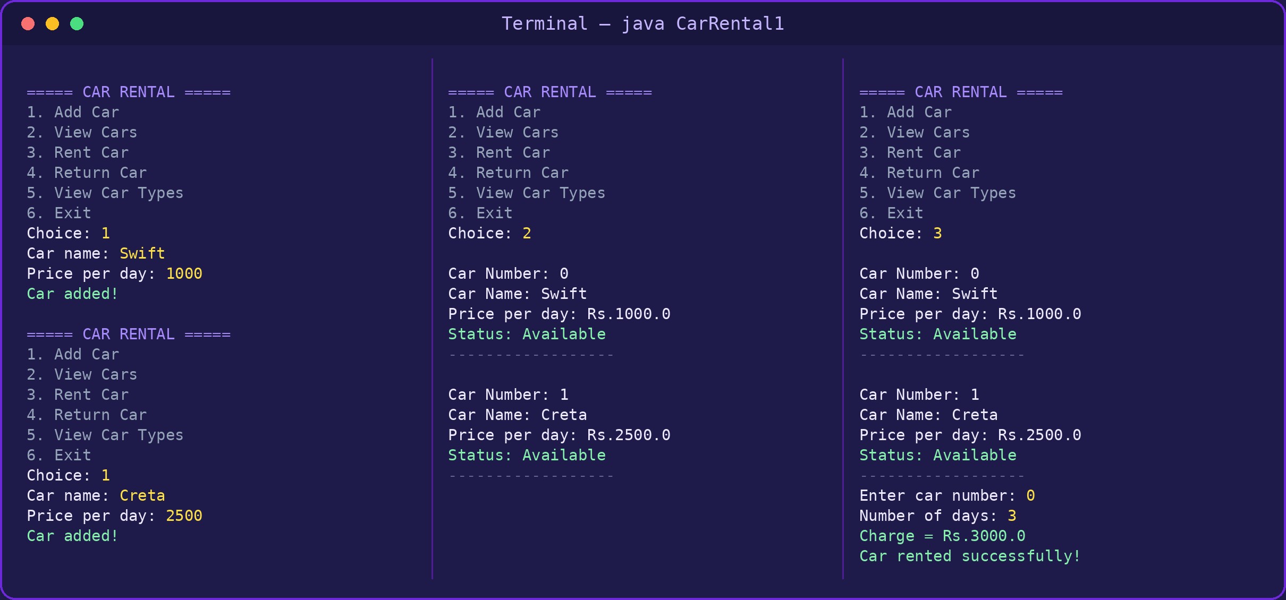
Program Output — Add, View and Rent Cars

Slide 12
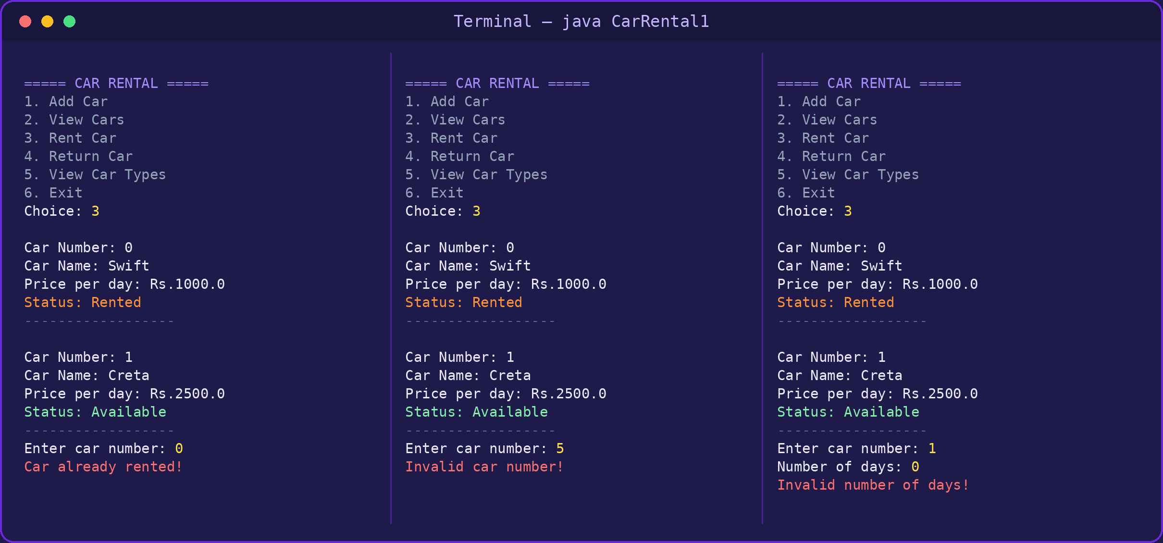
Program Output — Validation Checks

Slide 13
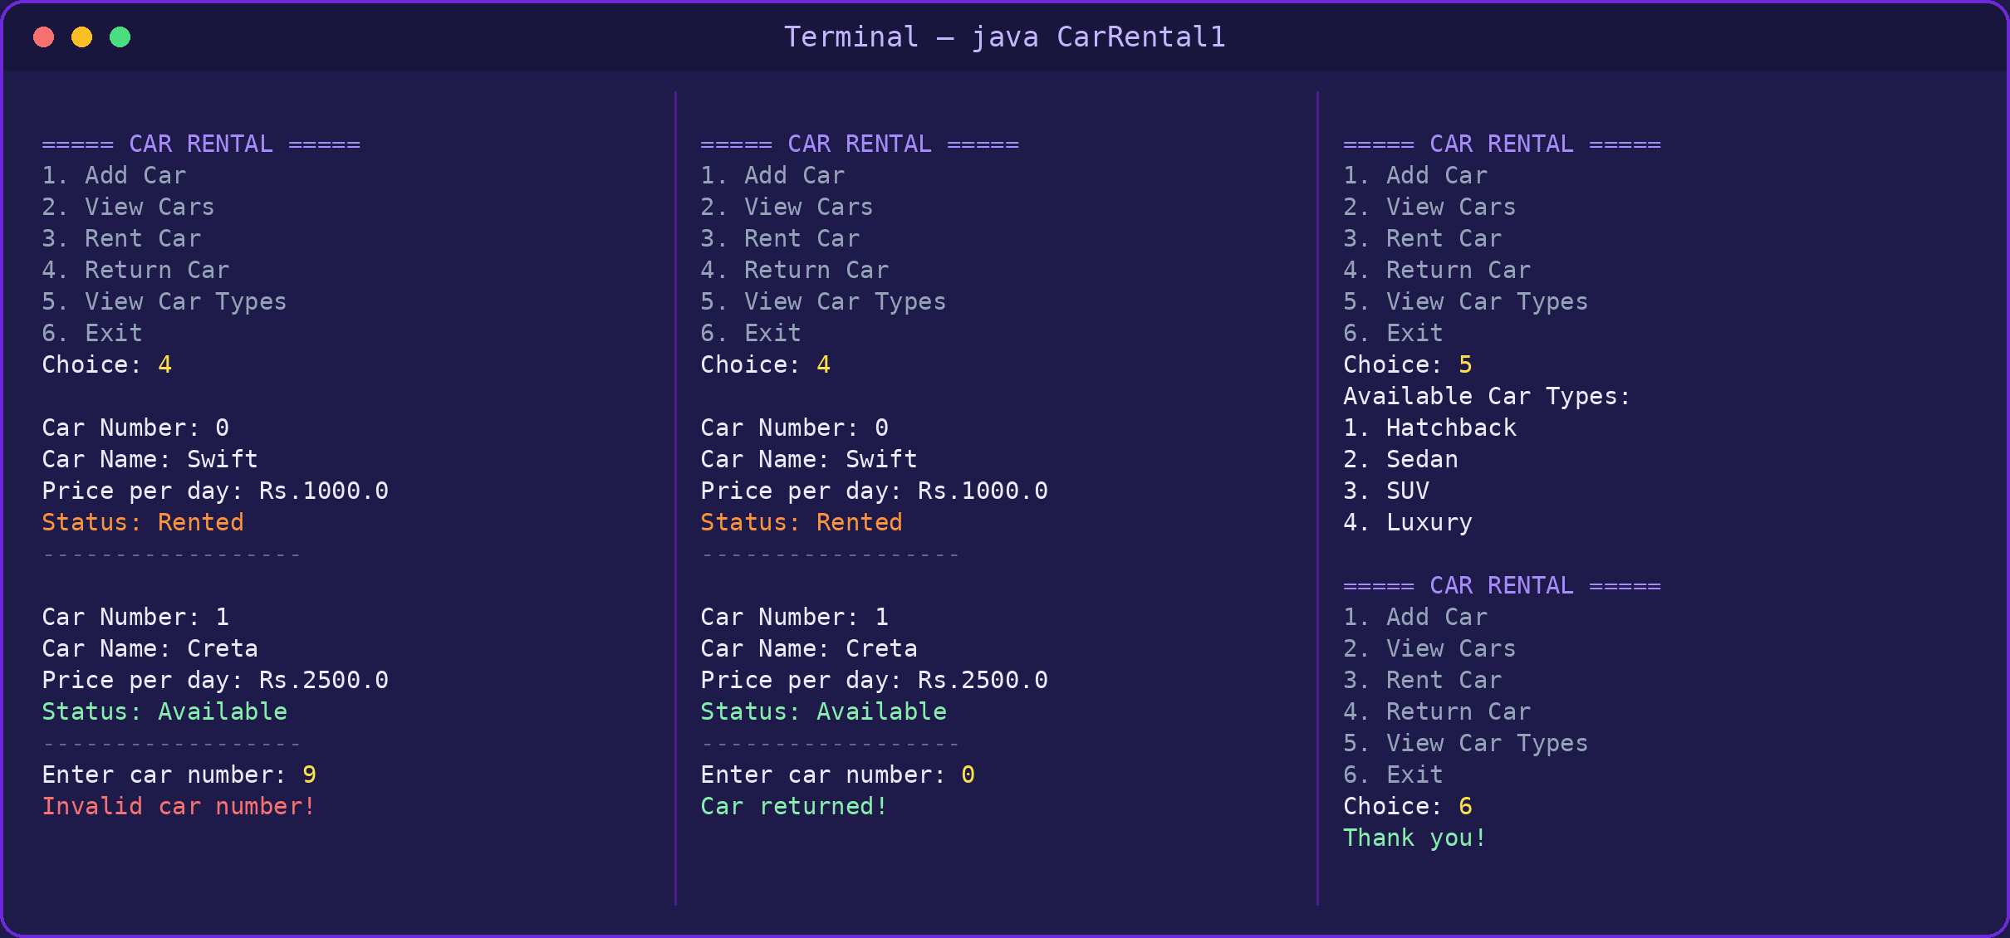
Program Output — Return, Car Types and Exit

Slide 14
Conclusion
This project demonstrates core Java concepts through a practical car rental example.
• Classes and objects represent cars
• ArrayList stores car objects
• Methods organize operations
• Loops and switch manage program flow
• Conditions and exception handling manage invalid situations
Future scope: customer details, payment options, rental dates and database storage.

Slide 15
Project Summary
Main features:
• Add and view cars
• Rent cars and calculate charges
• Return cars and update availability
• Display car categories
Key Java concepts: classes, objects, arrays, ArrayList, methods, loops, switch, if-else and try-catch.
Example: If a car costs Rs. 1,000 per day and is rented for 3 days, the charge is Rs. 3,000.

